Slide 1
1.2.1 System Software
Name?

Slide 2
1.2.1 System Software
A Level | Specification point description
1.2.1a | The need for, function and purposes of operating systems
1.2.1b | Memory management (paging, segmentation and virtual memory)
1.2.1c | Interrupts, the role of interrupts and Interrupt Service Routines (ISR), role within the fetch decode execute cycle
1.2.1d | Scheduling: round robin, first come first served, multi-level feedback queues, shortest job first and shortest remaining time
1.2.1e | Distributed, embedded, multi-tasking, multi-user and real time operating systems
1.2.1f | BIOS
1.2.1g | Device drivers
1.2.1h | Virtual machines, any instance where software is used to take on the function of a machine including executing intermediate code or running an operating system within another

Slide 3

Contents:
Before attempting these activities, you need to have watched the following videos to help answer the Key Questions and made a set of notes as instructed:
Need for Operating Systems – KQ: Why do computers need an operating system like Windows/Linux/MacOS?
Paging, Segmentation and Virtual Memory – KQ: How does a computer handle running out of memory and why does it slow down?
Interrupts – KQ: What causes an interrupt to the CPU and how is it handled?
Scheduling – KQ: From all the open programs in memory, how does the CPU decide which process to execute?
Types of Operating System – KQ: What are the features of different types of operating system?
BIOS – KQ:What is the relationship between these terms: BIOS, ROM, CMOS, POST, bootstrap and kernel?
Device Drivers – KQ: What is the purpose of a device driver?
Virtual Machines – KQ: What is a virtual machine?

Slide 4
Why do computers need an operating system like Windows/Linux/MacOS?
Key Question

Slide 5


1.1.1 Structure and function of the processor
1.2.1 Operating Systems - System Software
The arithmetic logic unit; ALU, Control Unit and Registers (Program Counter; PC, Accumulator; ACC, Memory Address Register; MAR, Memory Data Register; MDR, Current Instruction Register; CIR).
The need for, function and purposes of operating systems
Identify and describe all the tasks that you would expect a modern Operating system like Windows to perform. The first one has been done for you as an example.
Managing the processor
Deciding which process to execute next. Splitting up tasks and switching between them in order to Multi task

Slide 6
1.1.1 Structure and function of the processor
1.2.1 Operating Systems - System Software
The arithmetic logic unit; ALU, Control Unit and Registers (Program Counter; PC, Accumulator; ACC, Memory Address Register; MAR, Memory Data Register; MDR, Current Instruction Register; CIR).
The need for, function and purposes of operating systems
User
Applications
Operating System
Hardware
Describe what this illustration shows.
Does the user ever interact with the operating system?

Slide 7
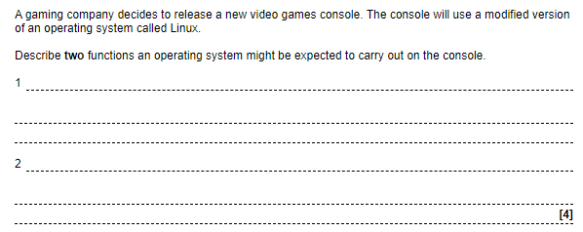
1.1.1 Structure and function of the processor
1.2.1 Operating Systems - System Software
The arithmetic logic unit; ALU, Control Unit and Registers (Program Counter; PC, Accumulator; ACC, Memory Address Register; MAR, Memory Data Register; MDR, Current Instruction Register; CIR).
The need for, function and purposes of operating systems

Slide 8
How does a computer handle running out of memory and why does it slow down?
Key question

Slide 9
1.1.1 Structure and function of the processor
1.2.1 Operating Systems - System Software
The arithmetic logic unit; ALU, Control Unit and Registers (Program Counter; PC, Accumulator; ACC, Memory Address Register; MAR, Memory Data Register; MDR, Current Instruction Register; CIR).
Memory management (paging, segmentation and virtual memory)
Complete the following table to compare the Paging and Segmentation method of dividing memory
Similarities | Differences

Slide 10
1.1.1 Structure and function of the processor
1.2.1 Operating Systems - System Software
The arithmetic logic unit; ALU, Control Unit and Registers (Program Counter; PC, Accumulator; ACC, Memory Address Register; MAR, Memory Data Register; MDR, Current Instruction Register; CIR).
Memory management (paging, segmentation and virtual memory)
The following illustration shows an abstraction of the computer memory in a typical state.
Each of the boxes represent part of a program.
The letter in the box indicates which program it belongs to.
The number in the box indicates the sequence of the instruction in the program.
The colour of the box indicates the type of code in the program:
orange are sections of iterations: for/while looping commands
blue are sections of conditions: if/then/else commands
green are all other types of commands.
RAM
A1
A2
A3
B1
B2
B3
A4
A5
B4
B5
B6
C3
C4
C5
B7

Slide 11
1.1.1 Structure and function of the processor
1.2.1 Operating Systems - System Software
The arithmetic logic unit; ALU, Control Unit and Registers (Program Counter; PC, Accumulator; ACC, Memory Address Register; MAR, Memory Data Register; MDR, Current Instruction Register; CIR).
Memory management (paging, segmentation and virtual memory)
Using the illustration, explain the concept of virtual memory, why it is needed and how it is used
RAM
A1
A2
A3
B1
B2
B3
A4
A5
B4
B5
B6
C3
C4
C5
B7
Virtual Memory on HDD.
A6
A7
B8
B9
B10
B11
C1
C2

Slide 12
1.1.1 Structure and function of the processor
1.2.1 Operating Systems - System Software
The arithmetic logic unit; ALU, Control Unit and Registers (Program Counter; PC, Accumulator; ACC, Memory Address Register; MAR, Memory Data Register; MDR, Current Instruction Register; CIR).
Memory management (paging, segmentation and virtual memory)
Annotate the illustration to explain whether it is an abstraction of paging or segmentation.
RAM
A1
A2
A3
B1
B2
B3
A4
A5
B4
B5
B6
C3
C4
C5
B7
Virtual Memory on HDD
A6
A7
B8
B9
B10
B11
C1
C2

Slide 13
1.1.1 Structure and function of the processor
1.2.1 Operating Systems - System Software
The arithmetic logic unit; ALU, Control Unit and Registers (Program Counter; PC, Accumulator; ACC, Memory Address Register; MAR, Memory Data Register; MDR, Current Instruction Register; CIR).
Memory management (paging, segmentation and virtual memory)
Change the illustration to show the alternative memory management technique.
Annotate the illustration to explain the difference.
RAM
A1
A2
A3
B1
B2
B3
A4
A5
B4
B5
B6
C3
C4
C5
B7
Virtual Memory on HDD
A6
A7
B8
B9
B10
B11
C1
C2

Slide 14
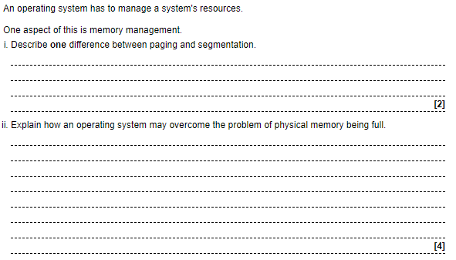
1.1.1 Structure and function of the processor
1.2.1 Operating Systems - System Software
The arithmetic logic unit; ALU, Control Unit and Registers (Program Counter; PC, Accumulator; ACC, Memory Address Register; MAR, Memory Data Register; MDR, Current Instruction Register; CIR).
Memory management (paging, segmentation and virtual memory)

Slide 15

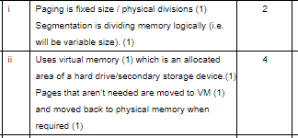
1.1.1 Structure and function of the processor
1.2.1 Operating Systems - System Software
The arithmetic logic unit; ALU, Control Unit and Registers (Program Counter; PC, Accumulator; ACC, Memory Address Register; MAR, Memory Data Register; MDR, Current Instruction Register; CIR).
Memory management (paging, segmentation and virtual memory)

Slide 16
What causes an interrupt to the CPU and how is it handled?
Key question

Slide 17
1.1.1 Structure and function of the processor
1.2.1 Operating Systems - System Software
The arithmetic logic unit; ALU, Control Unit and Registers (Program Counter; PC, Accumulator; ACC, Memory Address Register; MAR, Memory Data Register; MDR, Current Instruction Register; CIR).
Interrupts, the role of interrupts and Interrupt Service Routines (ISR), role within the fetch decode execute cycle
Put this sequence of events in the correct order left to right.
Copy any boxes you need to show how an interrupt is serviced.
Any higher priority interrupts to be processed?
Execute instruction
Fetch next instruction
Put registers on the memory stack
Decode instruction
Pop registers off the memory stack
Interrupt service routine loaded

Slide 18
1.1.1 Structure and function of the processor
1.2.1 Operating Systems - System Software
The arithmetic logic unit; ALU, Control Unit and Registers (Program Counter; PC, Accumulator; ACC, Memory Address Register; MAR, Memory Data Register; MDR, Current Instruction Register; CIR).
Interrupts, the role of interrupts and Interrupt Service Routines (ISR), role within the fetch decode execute cycle
Match the type of interrupt to its description.
Research and explain some of the terms used: parity error, arithmetic overflow & buffer.
Buffer almost empty
Hardware
Signals the completion of a data transfer between devices
Shutdown to start triggered by the user pressing the off button
Software
Memory parity error
Illegal instruction encountered in interpreted code
I/O
Arithmetic overflow
Internal clock triggers suspending a running process

Slide 19
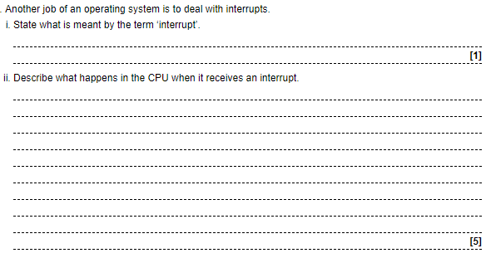
1.1.1 Structure and function of the processor
1.2.1 Operating Systems - System Software
The arithmetic logic unit; ALU, Control Unit and Registers (Program Counter; PC, Accumulator; ACC, Memory Address Register; MAR, Memory Data Register; MDR, Current Instruction Register; CIR).
Interrupts, the role of interrupts and Interrupt Service Routines (ISR), role within the fetch decode execute cycle

Slide 20
From all the open programs in memory, how does the CPU decide which process to execute?
Key question

Slide 21
1.1.1 Structure and function of the processor
1.2.1 Operating Systems - System Software
The arithmetic logic unit; ALU, Control Unit and Registers (Program Counter; PC, Accumulator; ACC, Memory Address Register; MAR, Memory Data Register; MDR, Current Instruction Register; CIR).
Scheduling: round robin, first come first served, multi-level feedback queues, shortest job first and shortest remaining time
Match the scheduling algorithms to their descriptions.
What does it mean to be pre-emptive?
Which algorithms are pre-emptive and which are not?
FCFS (First come first served)
SJF (Shortest job first)
RR (Round robin)
SRT (Shortest remaining time)
Jobs are sorted in the ready queue according to the estimated processor time needed.
.
MFQ (Multi-level feedback queues)
Each process is given a maximum length of processor time in the running state after which it is put back into the ready queue.
The ready queue is sorted on the estimated time to complete the process. Processes that arrive having a shorter time to complete than the current running process are moved to the running state.
Several ready queues are used each with a different scheduling algorithm. Jobs are able to move between queues as their priorities change.
The first job to enter the ready queue is the first to enter the running state.

Slide 22
1.1.1 Structure and function of the processor
1.2.1 Operating Systems - System Software
The arithmetic logic unit; ALU, Control Unit and Registers (Program Counter; PC, Accumulator; ACC, Memory Address Register; MAR, Memory Data Register; MDR, Current Instruction Register; CIR).
Scheduling: round robin, first come first served, multi-level feedback queues, shortest job first and shortest remaining time
Can you rank each of the algorithms, which ones are the best and why?
FCFS (First come first served)
SJF (Shortest job first)
RR (Round robin)
SRT (Shortest remaining time)
MFQ (Multi-level feedback queues)

Slide 23
1.1.1 Structure and function of the processor
1.2.1 Operating Systems - System Software
The arithmetic logic unit; ALU, Control Unit and Registers (Program Counter; PC, Accumulator; ACC, Memory Address Register; MAR, Memory Data Register; MDR, Current Instruction Register; CIR).
Scheduling: round robin, first come first served, multi-level feedback queues, shortest job first and shortest remaining time
Use the spreadsheet provided to show how one scheduling algorithm is better than another by comparing the average wait time of 3 processes. Consider this example of 3 processes for FCFS with cycles required to complete being 6, 3 and 9. Create examples for FCFS, RR, SJF & SRT to show the order of execution, wait time for each process and average wait time for 3 processes: A (20 cycles), B (10 cycles), C (5 cycles). Assume a time slice of 5 cycles.
TAKE A SCREENSHOT OF THE RESULT AND PASTE ONE THE NEXT SLIDE
Download spreadsheet
Time | 0 | 3 | 6 | 9 | 12 | 15 | 18 |  |  |  |  |  |  |  |  |  | Process ID | CPU cycles to complete
FCFS |  |  |  |  |  |  |  |  |  |  |  |  |  |  |  |  | A | 6
 | A Wait = 0 |  |  |  |  |  |  |  |  |  |  |  |  |  |  |  | B | 3
 |  |  | B Wait = 6 |  |  |  |  |  |  |  |  |  |  |  |  |  | C | 9
 |  |  |  | C Wait = 9 |  |  |  |  |  | Average Wait = 15/3 |  |  |  |  | 5

Slide 24
What are the features of different types of operating system?
Key question

Slide 25
1.1.1 Structure and function of the processor
1.2.1 Operating Systems - System Software
The arithmetic logic unit; ALU, Control Unit and Registers (Program Counter; PC, Accumulator; ACC, Memory Address Register; MAR, Memory Data Register; MDR, Current Instruction Register; CIR).
Distributed, embedded, multi-tasking, multi-user and real time operating systems
Use the following blank slides to create a presentation outlining the key features of the following types of operating systems: - Distributed - Embedded - Multi-tasking - Multi-user - Real time
Include the following in your presentation in the appropriate place: - Orbis - Rockwell Collins AFDS-770 - Windows - Big iron - Locus

Slide 26
Distributed Operating Systems

Slide 27
Embedded Operating Systems

Slide 28
Multi-tasking Operating Systems

Slide 29
Multi-user Operating Systems

Slide 30
Real time Operating Systems

Slide 31
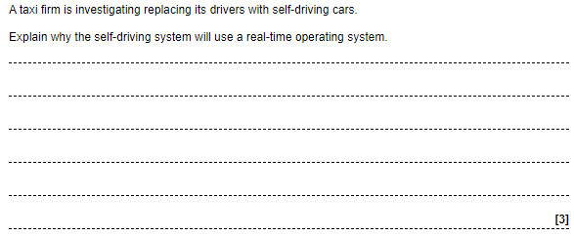
1.1.1 Structure and function of the processor
1.2.1 Operating Systems - System Software
The arithmetic logic unit; ALU, Control Unit and Registers (Program Counter; PC, Accumulator; ACC, Memory Address Register; MAR, Memory Data Register; MDR, Current Instruction Register; CIR).
Distributed, embedded, multi-tasking, multi-user and real time operating systems

Slide 32
What is the relationship between these terms: BIOS, ROM, CMOS, POST, bootstrap and kernel?
Key question

Slide 33
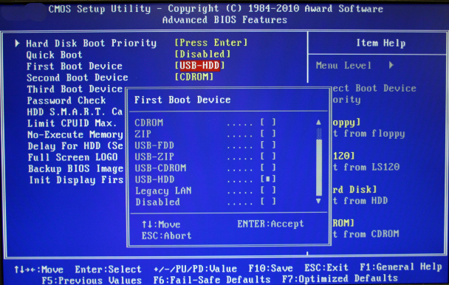
1.1.1 Structure and function of the processor
1.2.1 Operating Systems - System Software
The arithmetic logic unit; ALU, Control Unit and Registers (Program Counter; PC, Accumulator; ACC, Memory Address Register; MAR, Memory Data Register; MDR, Current Instruction Register; CIR).
BIOS
Explain the relevance of: - Why the BIOS is stored in ROM and CMOS? - POST (Power on self-test) - Boot loader (bootstrap) - Operating system kernel - Chernobyl virus - Gigabyte’s dual BIOS technology

Slide 34
What is the purpose of a device driver?
Key question

Slide 35




1.1.1 Structure and function of the processor
1.2.1 Operating Systems - System Software
The arithmetic logic unit; ALU, Control Unit and Registers (Program Counter; PC, Accumulator; ACC, Memory Address Register; MAR, Memory Data Register; MDR, Current Instruction Register; CIR).
Device Drivers
How could an analogy of a jigsaw puzzle explain the role of device drivers? Can you identify 4 examples of device drivers and use the labelled puzzle pieces to illustrate?
I/O Driver
Operating system
Operating system
USB Driver
Keyboard
USB Flash memory
Printer Driver
Video Driver
Printer
Operating system
Graphics card
Operating system

Slide 36
What is a virtual machine?
Key question

Slide 37
1.1.1 Structure and function of the processor
1.2.1 Operating Systems - System Software
The arithmetic logic unit; ALU, Control Unit and Registers (Program Counter; PC, Accumulator; ACC, Memory Address Register; MAR, Memory Data Register; MDR, Current Instruction Register; CIR).
Virtual machines, any instance where software is used to take on the function of a machine including executing intermediate code or running an operating system within another
In your own words explain the following: - Virtualised servers - Boot camp - Java byte code

Slide 38
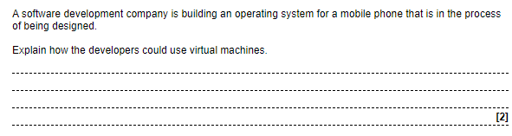
1.1.1 Structure and function of the processor
1.2.1 Operating Systems - System Software
The arithmetic logic unit; ALU, Control Unit and Registers (Program Counter; PC, Accumulator; ACC, Memory Address Register; MAR, Memory Data Register; MDR, Current Instruction Register; CIR).
Virtual machines, any instance where software is used to take on the function of a machine including executing intermediate code or running an operating system within another

Slide 39
Reflection & Revision checklist
Confidence | Clarification
☹ 😐 ☺ | Candidates need to have an understanding of why an operating system is required, along with the different tasks it performs within a computer system (e.g. resource management, file management, interrupt handling, security, providing a platform for software to run, providing a user interface and providing utilities).
☹ 😐 ☺ | Candidates need to understand how operating systems manage memory. They need to understand the need for, purpose and function of paging to divide memory into usable fixed-size pages and how this aids in the transfer of memory for example virtual memory.
☹ 😐 ☺ | Candidates need to understand what is meant by segmentation and how memory is divided into segments to allow access to memory.
☹ 😐 ☺ | Candidates need to understand what is meant by virtual memory and why this is needed in a computer system.
☹ 😐 ☺ | Candidates need to understand how paging is used in virtual memory, and the benefits and drawbacks of having and using virtual memory in a computer system.
☹ 😐 ☺ | Candidates need to understand the purpose of interrupts within a computer system, why an interrupt might be generated and what happens within the CPU and memory in order to call an interrupt service routine.
☹ 😐 ☺ | Candidates need to understand the need for scheduling of tasks by an operating system and the benefits that scheduling brings.
☹ 😐 ☺ | Candidates need to understand that there are different scheduling algorithms, with each having benefits and drawbacks for tasks with specific characteristics.
☹ 😐 ☺ | Candidates need to understand how the following scheduling algorithms work; round robin, first come first served, multi-level feedback queue, shortest job first and shortest remaining time.
☹ 😐 ☺ | Candidates need to understand the different (and often overlapping) classifications of operating systems (distributed, embedded, multi-tasking, multi-user and real time), including the key features of each. They should be able to recommend (and justify) a type of operating system for a given scenario.
☹ 😐 ☺ | Candidates need to understand the role of the BIOS in a computer system, and the steps that the BIOS goes through to start a computer.
☹ 😐 ☺ | Candidates need to understand what is meant by ‘device drivers’ and why they are needed for communication between hardware and the operating system.
☹ 😐 ☺ | Candidates should be able to describe what is meant by a virtual machine, how they can be used to execute intermediate code, how they can be used to run a software driven machine inside a physical machine and the benefits and drawbacks of each approach.
Notes:
Clarification about what you need to know.

